Slide 1


PRESENTED BY
NGATSING TAKAM FRANCK ARTHUR
2024 – 2025 WELCOME TO MY PRESENTATION
RIODUSLINK
AFRICAN INSTITUE OF COMPUTER SCIENCE

Slide 2

Conception and Realization of a Digital Platform for Professional Connections and Opportunities in Cameroon
Presented by
NGATSING TAKAM Franck Arthur
Level III Student at AICS Cameroon
RIODUSLINK

Slide 3

Table of Contents
Introduction
Context and problematic
Objective and methodology
demonstration
conclusion
Thank You
RIODUSLINK

Slide 4


Introduction
Revolutionizing Cameroon's Job Market
Amid Fierce Job Struggles, Cameroonian Youth Seek Pathways to Success—RiodusLink's AI Intelligently Matches Skills to Dream Careers, Empowering Tomorrow's Workforce
RIODUSLINK

Slide 5

Context and problematics
Context
Traditional networking in Cameroon fragments connections and delays opportunities for youth amid rising unemployment.
Problematics
“HOW CAN WE DEVELOP A DIGITAL PLATFORM THAT FACILITATES PROFESSIONAL CONNECTIONS, STREAMLINES OPPORTUNITY DISCOVERY, AND ENHANCES ACCESS TO CAREER-RELATED RESOURCES FOR USERS IN CAMEROON?”
RIODUSLINK

Slide 6


Objective and methodology
Design RiodusLink as an AI-powered platform for seamless professional connections, job matching, and career tools in Cameroon—empowering seekers, employers, and networks..
RIODUSLINK

Slide 7
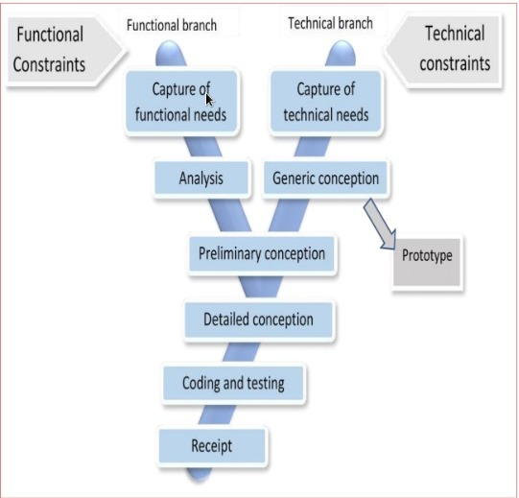

Methodology
Method:
UNIFIED MODELLING LANGUAGE
2 TRACK UNIFIED PROCESS
RIODUSLINK

Slide 8
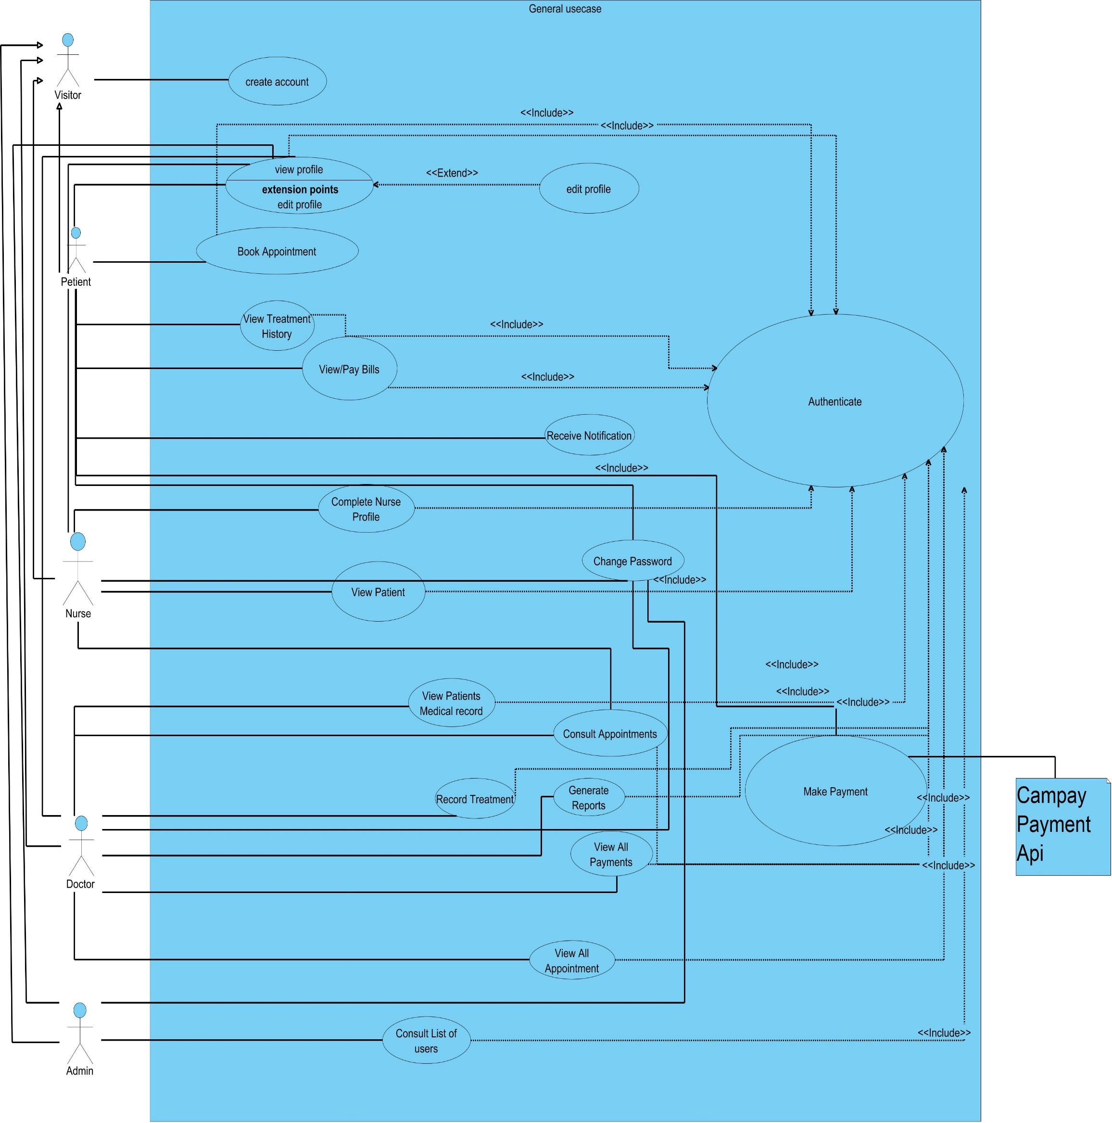
GENERAL
USECASE
RIODUSLINK

Slide 9
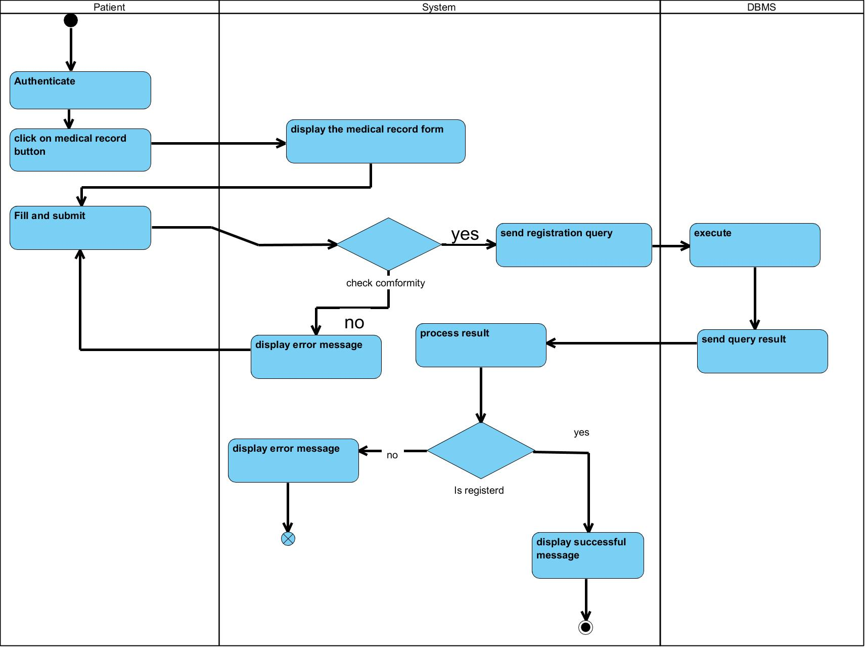
ACTIVITY
DIAGRAM
RIODUSLINK

Slide 10
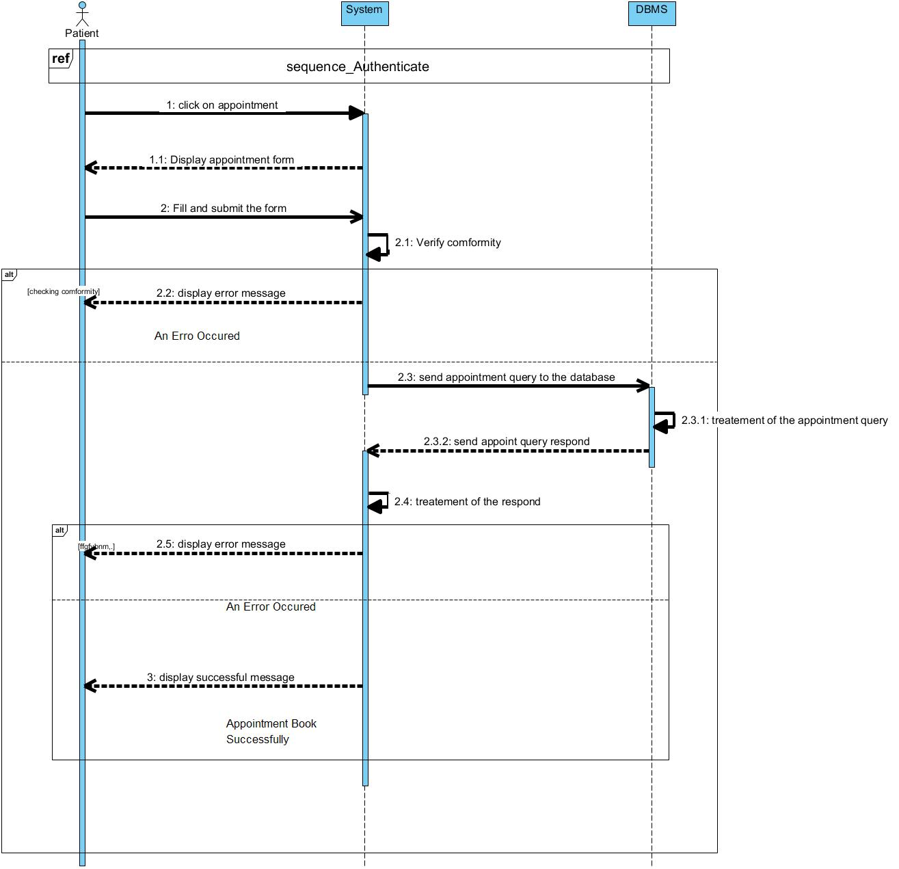
SEQUENCE
DIAGRAM
RIODUSLINK

Slide 11
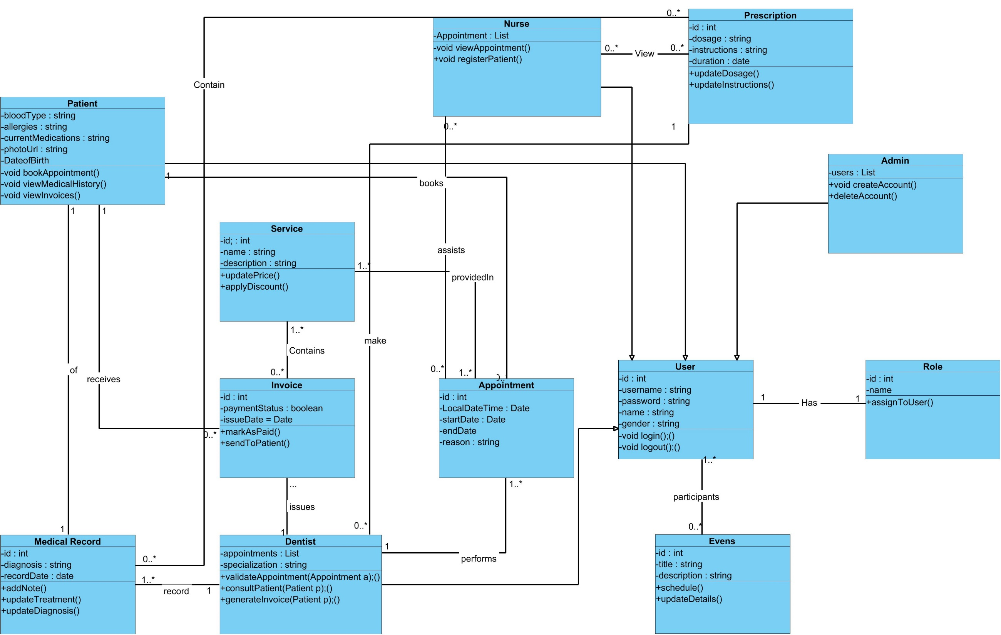
CLASS
DIAGRAM
www.reallygreatsite.com
RIODUSLINK

Slide 12








Programing
Tools
Visual studio code
Visual Paradigm
Laragon
Postman
GitHub
chrome
ROIDUSLINK

Slide 13
Demonstration
Login
Apply for a job
View applications
RIODUSLINK

Slide 14
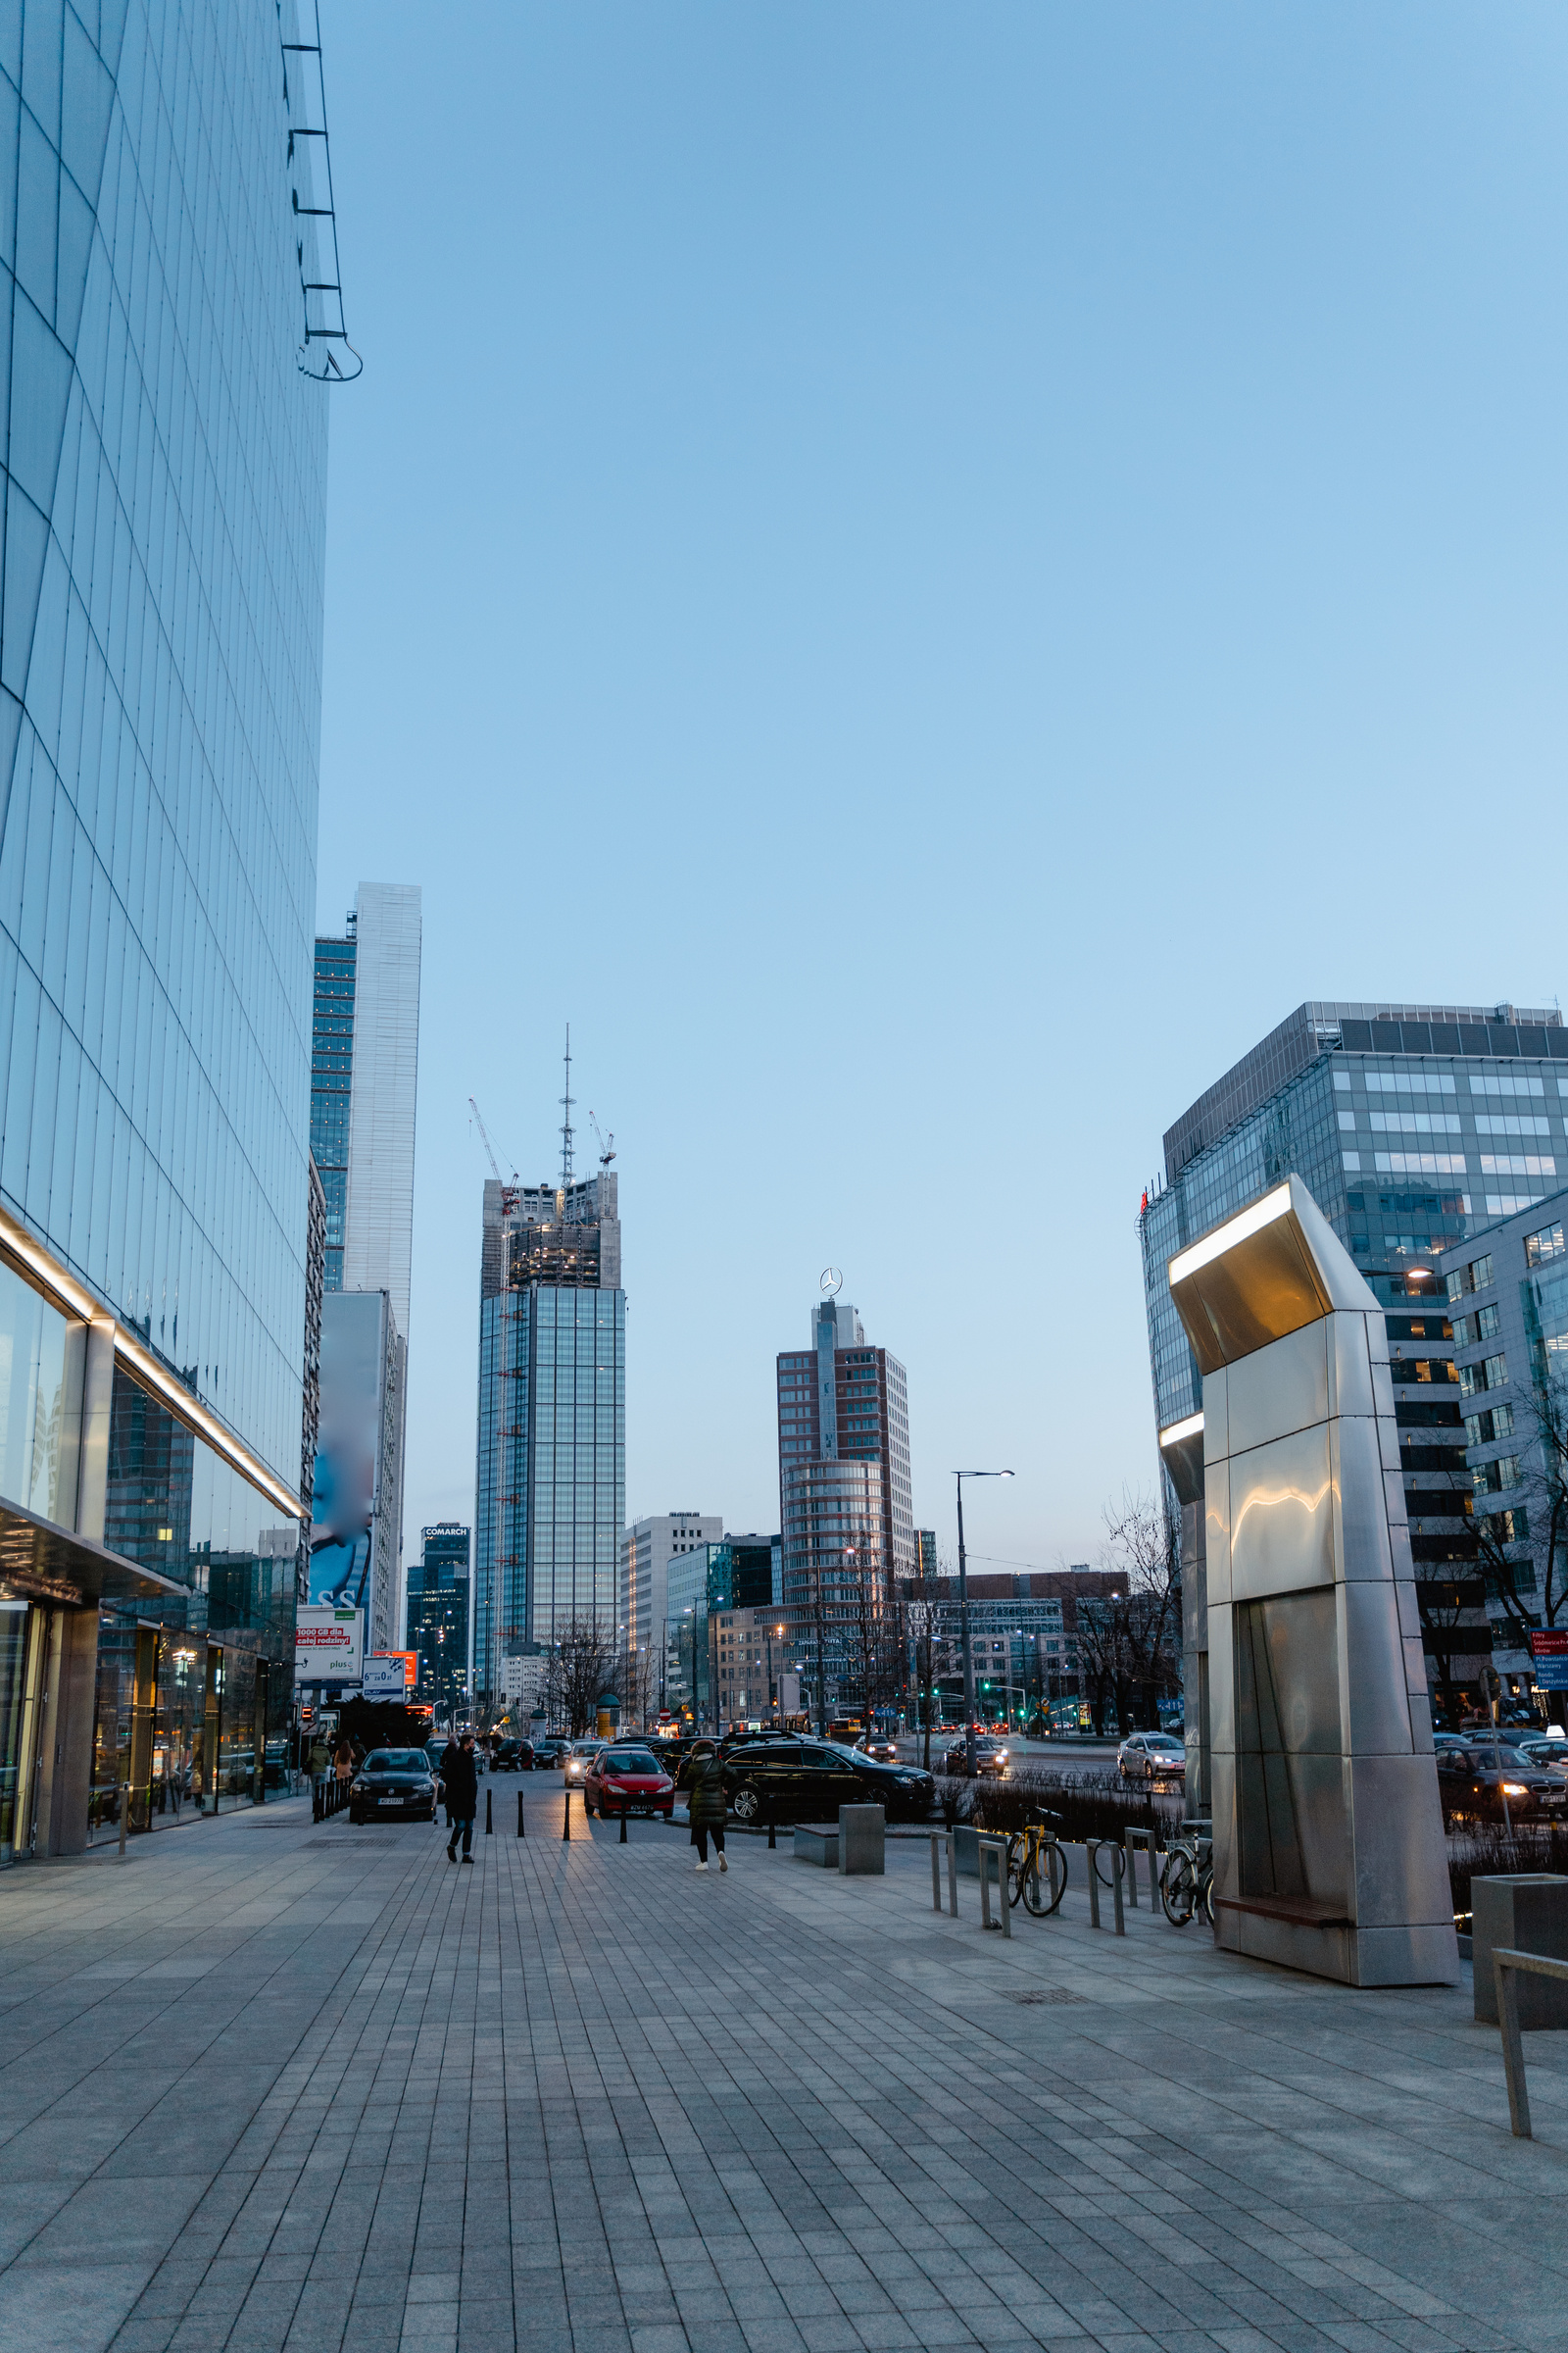
Conclusion
Connecting talent with opportunities
Objective:
transforms Cameroon's job market—connecting talent with opportunities through AI innovation, streamlined processes, and inclusive growth. Let's build a brighter future together: Empowering careers, one match at a time.
RIODUSLINK

Slide 15





Thank You
For further inquiries and information
The Fauget
hello@reallygreatsite.com
123 Anywhere St., Any City
RIODUSLNK
+123-456-7890
www.reallygreatsite.com

